Slide 1
How best to support collapsed heels? –
The effect of farriery intervention on hoof deformation and tendon strain
Prj:SPrj010

Slide 2
How best to support collapsed heels?
SPrj010
Dr. Renate Weller, Dr. Thilo Pfau, Peter Day, Dr. Chris Pardoe
Collaborators: Carl Bettison, Haydn Price and Simon Curtis
The Royal Veterinary College

Slide 3
Reasons why the study was performed
Collapsed (underrun) heels are a common problem in the racing Thoroughbred
Collapsed heels are associated with an increased risk of musculoskeletal injury
Shoeing horses with collapsed heels is a challenge
Scientific evidence on how to treat or or prevent heel collapse is scarce.

Slide 4
Relevance to the thoroughbred
Racing Thoroughbreds operate very close to their safety limits
Collapsed heels change biomechanics
They change the way the hoof deforms and hence shock absorption and load distribution in the limb
Optimising shock absorption and load distribution is a must to decrease the risk of musculoskeletal injury

Slide 5
Aims and objectives
The aim of this study was to determine the effect of different shoeing techniques on shock absorption and internal load distribution
The objectives were to assess how different shoes affect
the way the hoof deforms under load
the load the different tendons experience under load

Slide 6
What was done?
24 Thoroughbred front legs from 24 horses 12 with obvious and12 without collapsed heels were loaded in a material testing machine
Tendon strain was assessed with infrared cameras
Leg force with a force plate
Hoof deformation with a cine-xray technique
6 legs were also tested in a CT scanner
The following 5 conditions were tested on each leg:
Glue on plastic heart bar shoe
Aluminium racing plate with/without packer
Unshod with/without hoof support patches

Slide 7
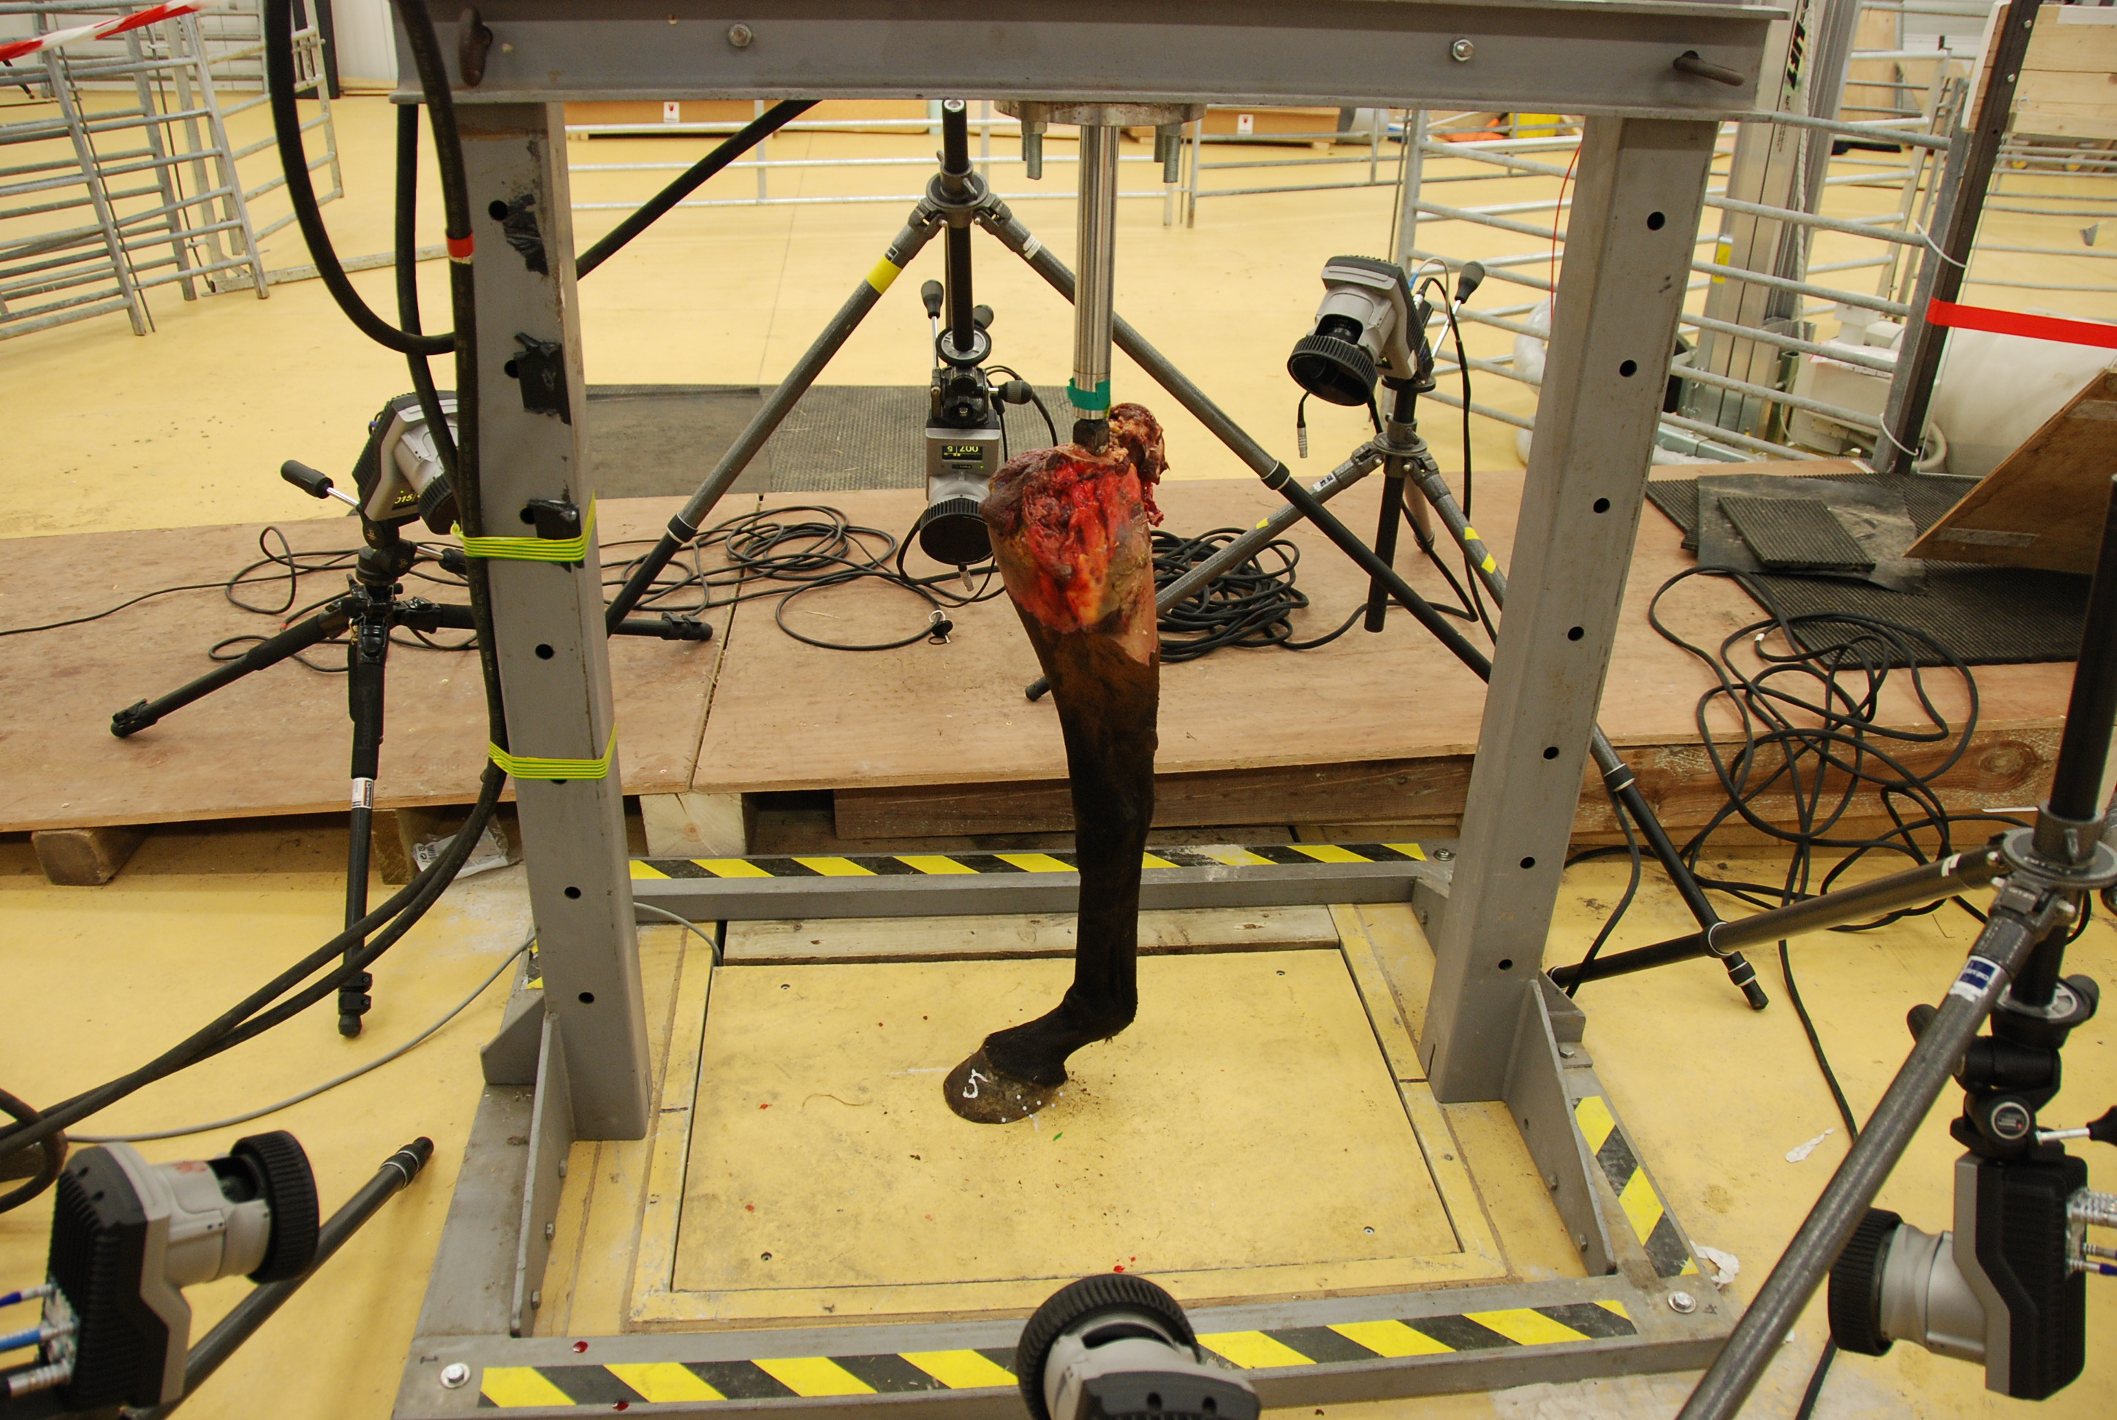
Measurement of tendon strain with a multi-camera infrared camera set-up

Slide 8
Significant changes in tendon strain
 | SDFT | ALDDFT | DDFT | SL
Glue on heart bar | Increased | No significant change | Decreased | Increased
Aluminium Racing Plate | Increased | Increased | Decreased | No significant change
Aluminium Racing Plate with packing material | No significant change | Increased | No significant change | Increased

Slide 9
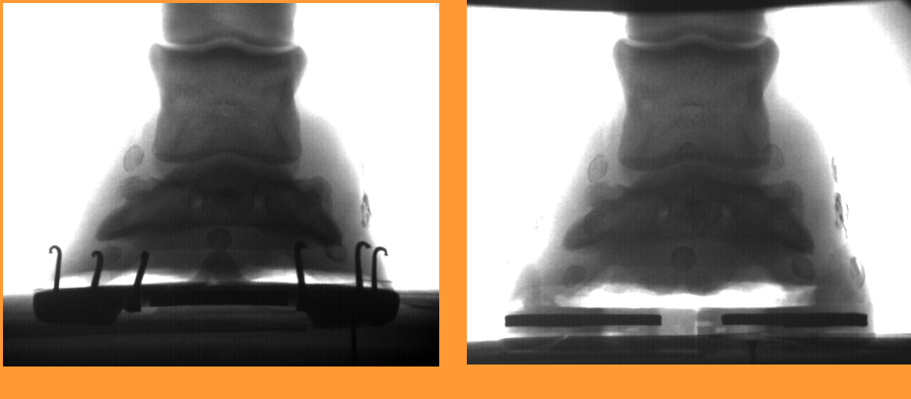
Cine-radiography used to assess effect of shoes on hoof kinematics

Slide 10
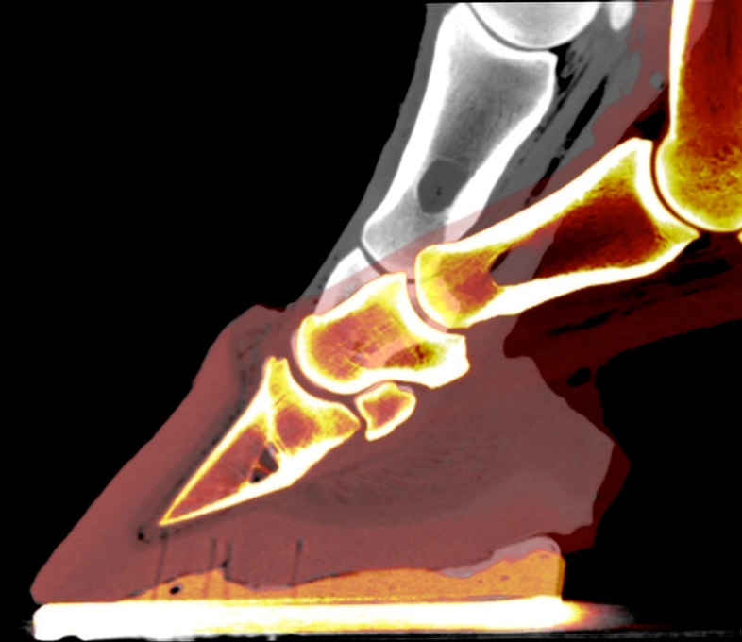
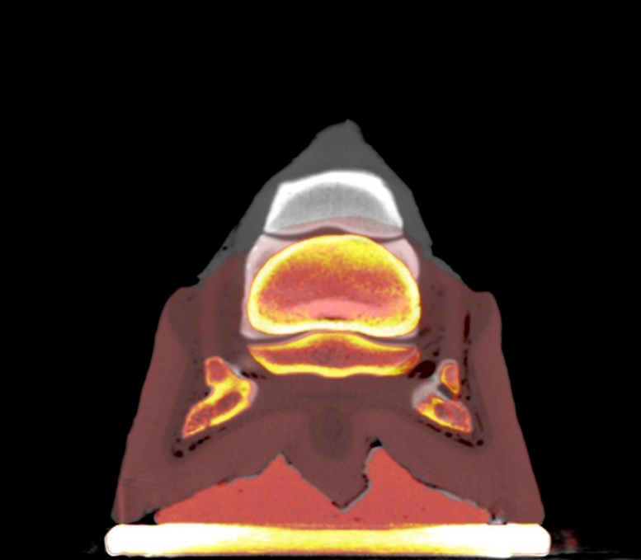
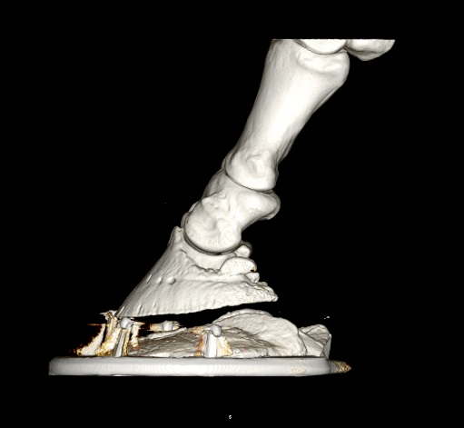
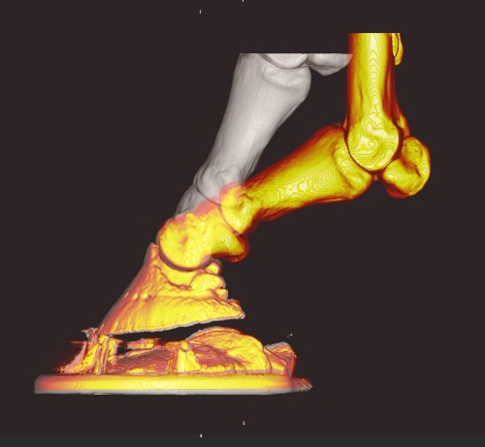
3D foot deformation with CT based models

Slide 11
Summary
Farriery intervention significantly affected hoof deformation and tendon strain:
Aluminium race plates with packer resulted in a decreased hoof deformation and an increased strain in the check and suspensory ligament
Aluminium racing plates without packing material increased check ligament and superficial flexor tendon strain
Glue-on shoes resulted in increased hoof deformation.
There was a high degree of variation between horses!

Slide 12
Impact on the thoroughbred
Shoeing significantly influences hoof deformation and hence shock absorption and tendon strain in horses with collapsed heels and this should be taken into consideration when shoeing horses with this condition.
Variation observed between horses makes it essential that shoeing is carefully tailored to the individual horse

Slide 13
Potential next steps
This study will form the basis for further in vivo clinical trials where the most effective in vitro method will be tested in live horses for correction or even better prevention of collapsed heels while optimising internal load distribution and hoof deformation.

